Slide 1


ECEN 403 Final Presentation Team 70: VFD Motor Controller Team Mackenzie Miller Andrew Nguyen Aidan Rader Ryan Regan Sponsor: John Lusher

Slide 2
Overview
Problem Statement: A motor control system is needed for an AC induction motor. Traditional motor control systems cannot adjust to varying load demands, resulting in poor energy efficiency, excessive heat generation, and premature component failure.
Solution Proposal: Develop a Variable Frequency Drive (VFD) motor control system to adjust frequency and voltage to load demands, resulting in improved motor controllability, optimized energy efficiency, enhanced safety, and extended component lifespan.

Slide 3
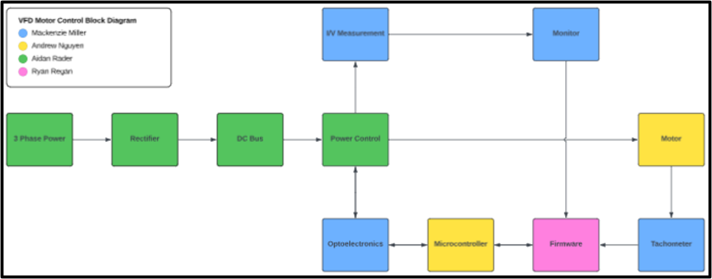
Overview

Slide 4
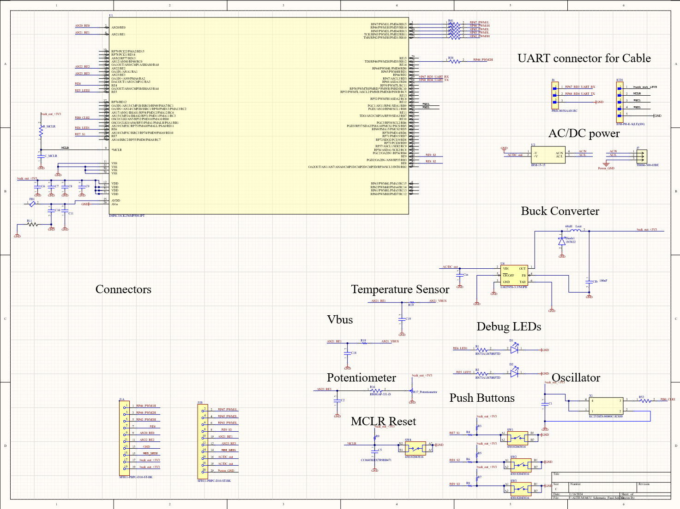
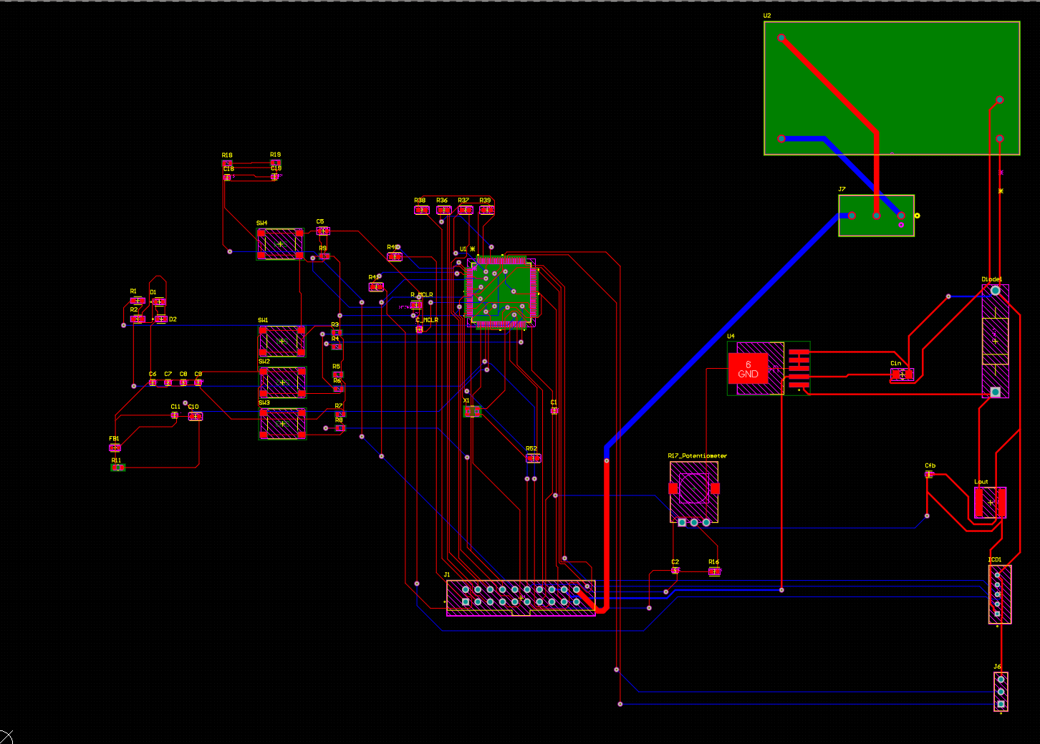
Microcontroller
Finished PCB and schematic designs

Slide 5
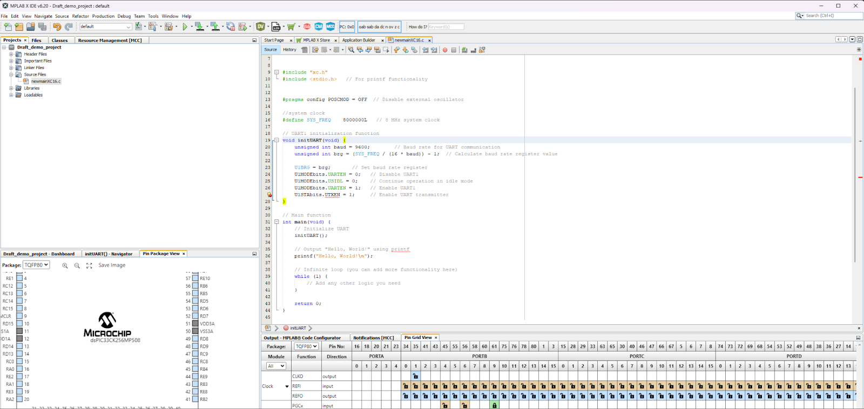
MCU Continued
Practiced soldering using soldering kit while I waited for parts come in
Ran simulations on schematic
Began code for final demo

Slide 6
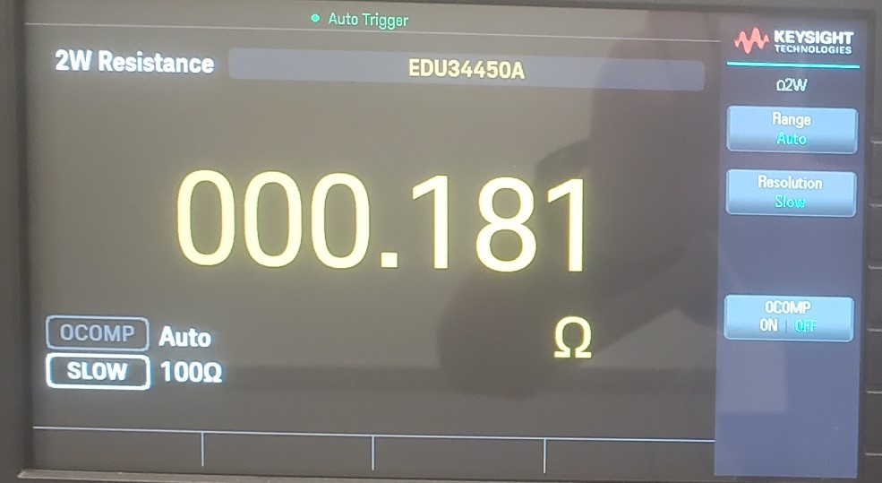
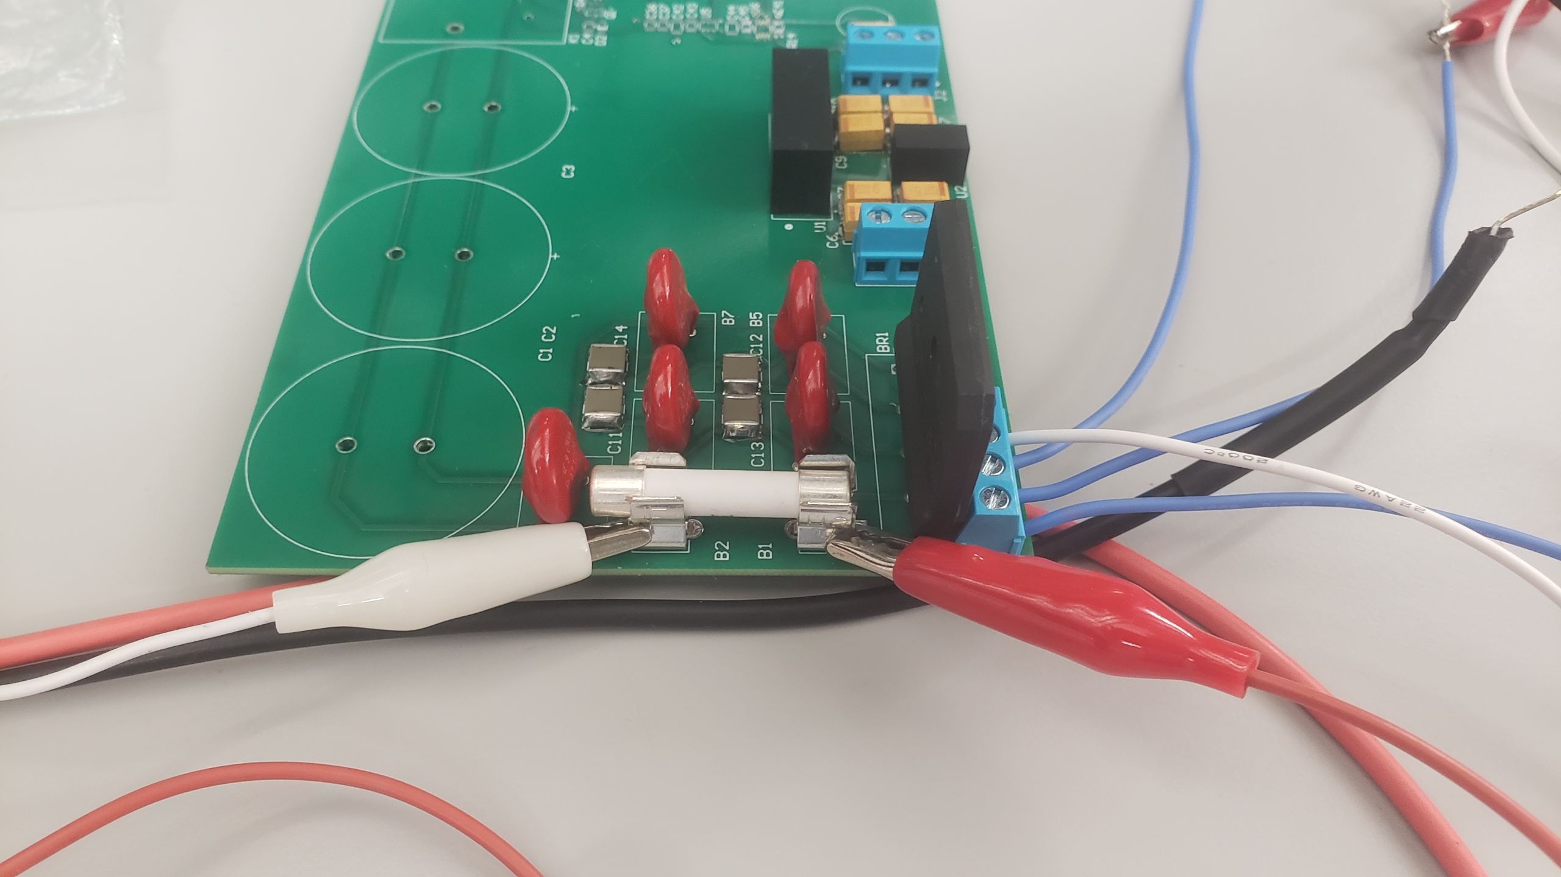
Power
Aidan Rader
Task | Status
PCB Fabrication | Complete
Rectifier 5VAC to 6.1VDC | Complete
Fuse < 0.5Ω | Complete

Slide 7
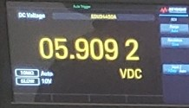
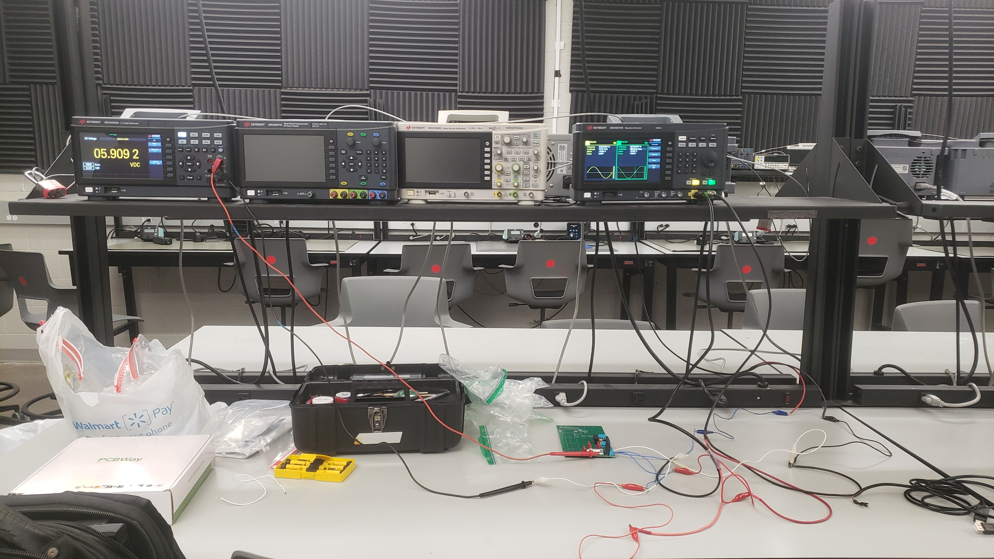
Power
Aidan Rader

Slide 8
Firmware
Firmware for development board to produce three-phase PWM signals completed.
Potentiometer can change the frequency of the PWM wave by increasing the code's step size while iterating through sine wave table.

Slide 9
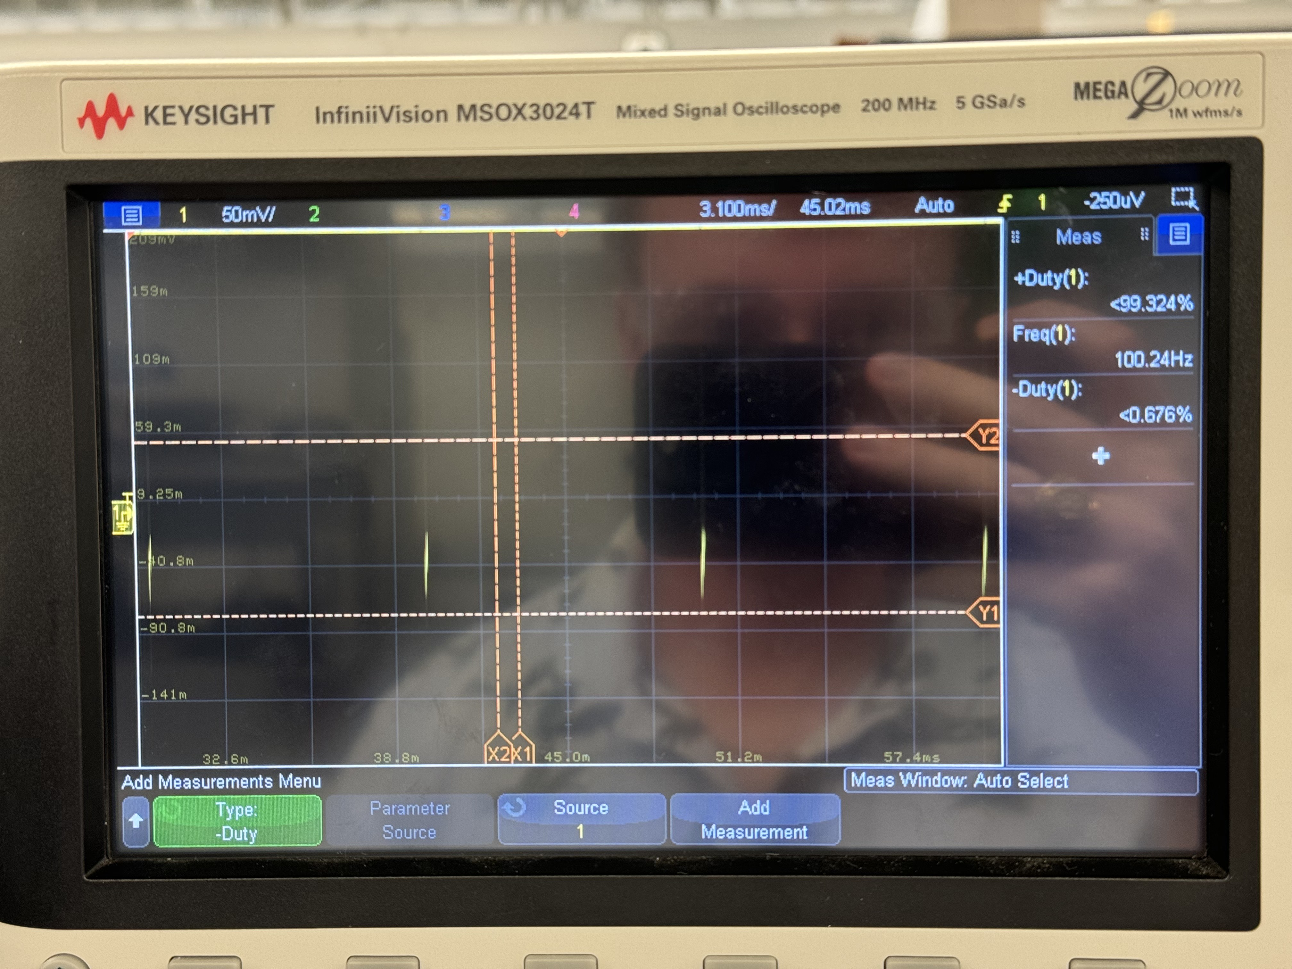
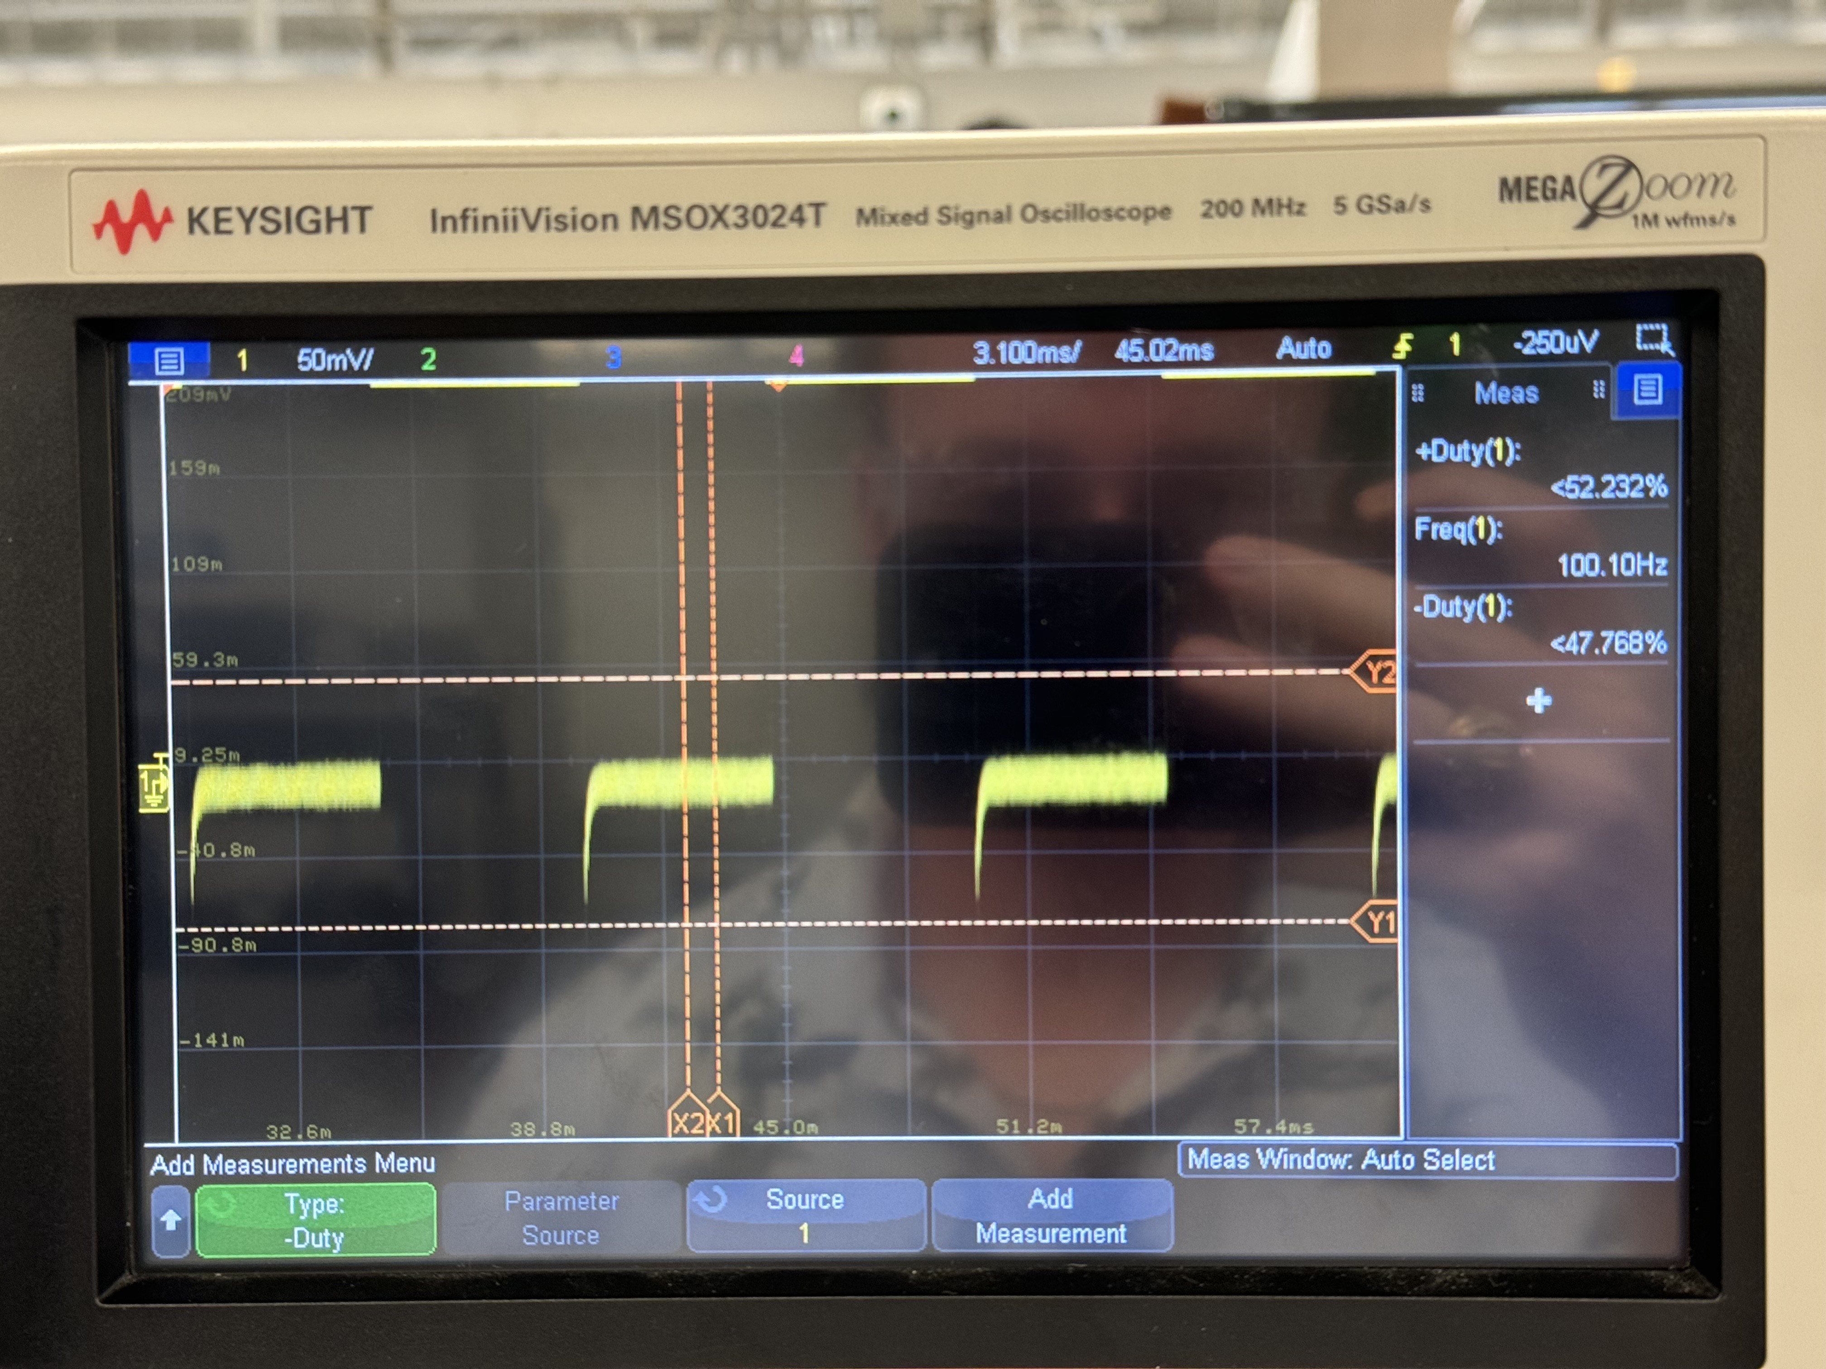
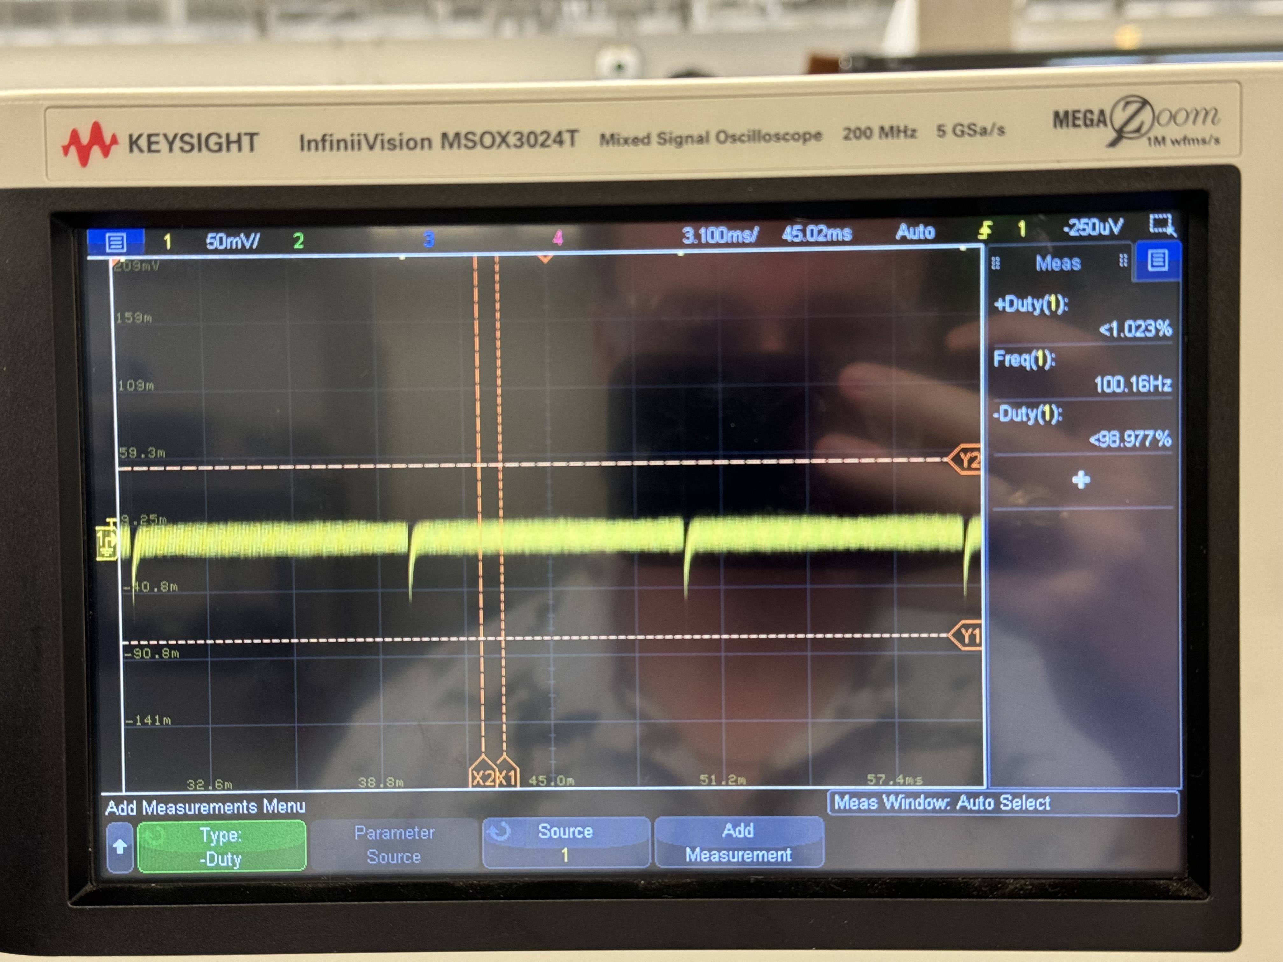
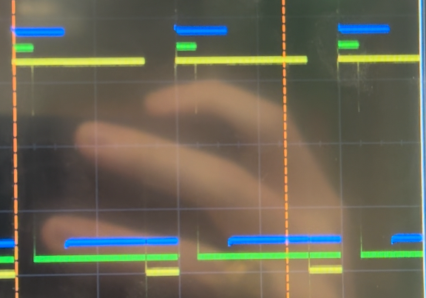
Firmware Continued

Slide 10
Optoelectronics
Assembled 1/3 of PCB board
Tested for continuity at low power
Remaining 2/3 to be assembled this week

Slide 11
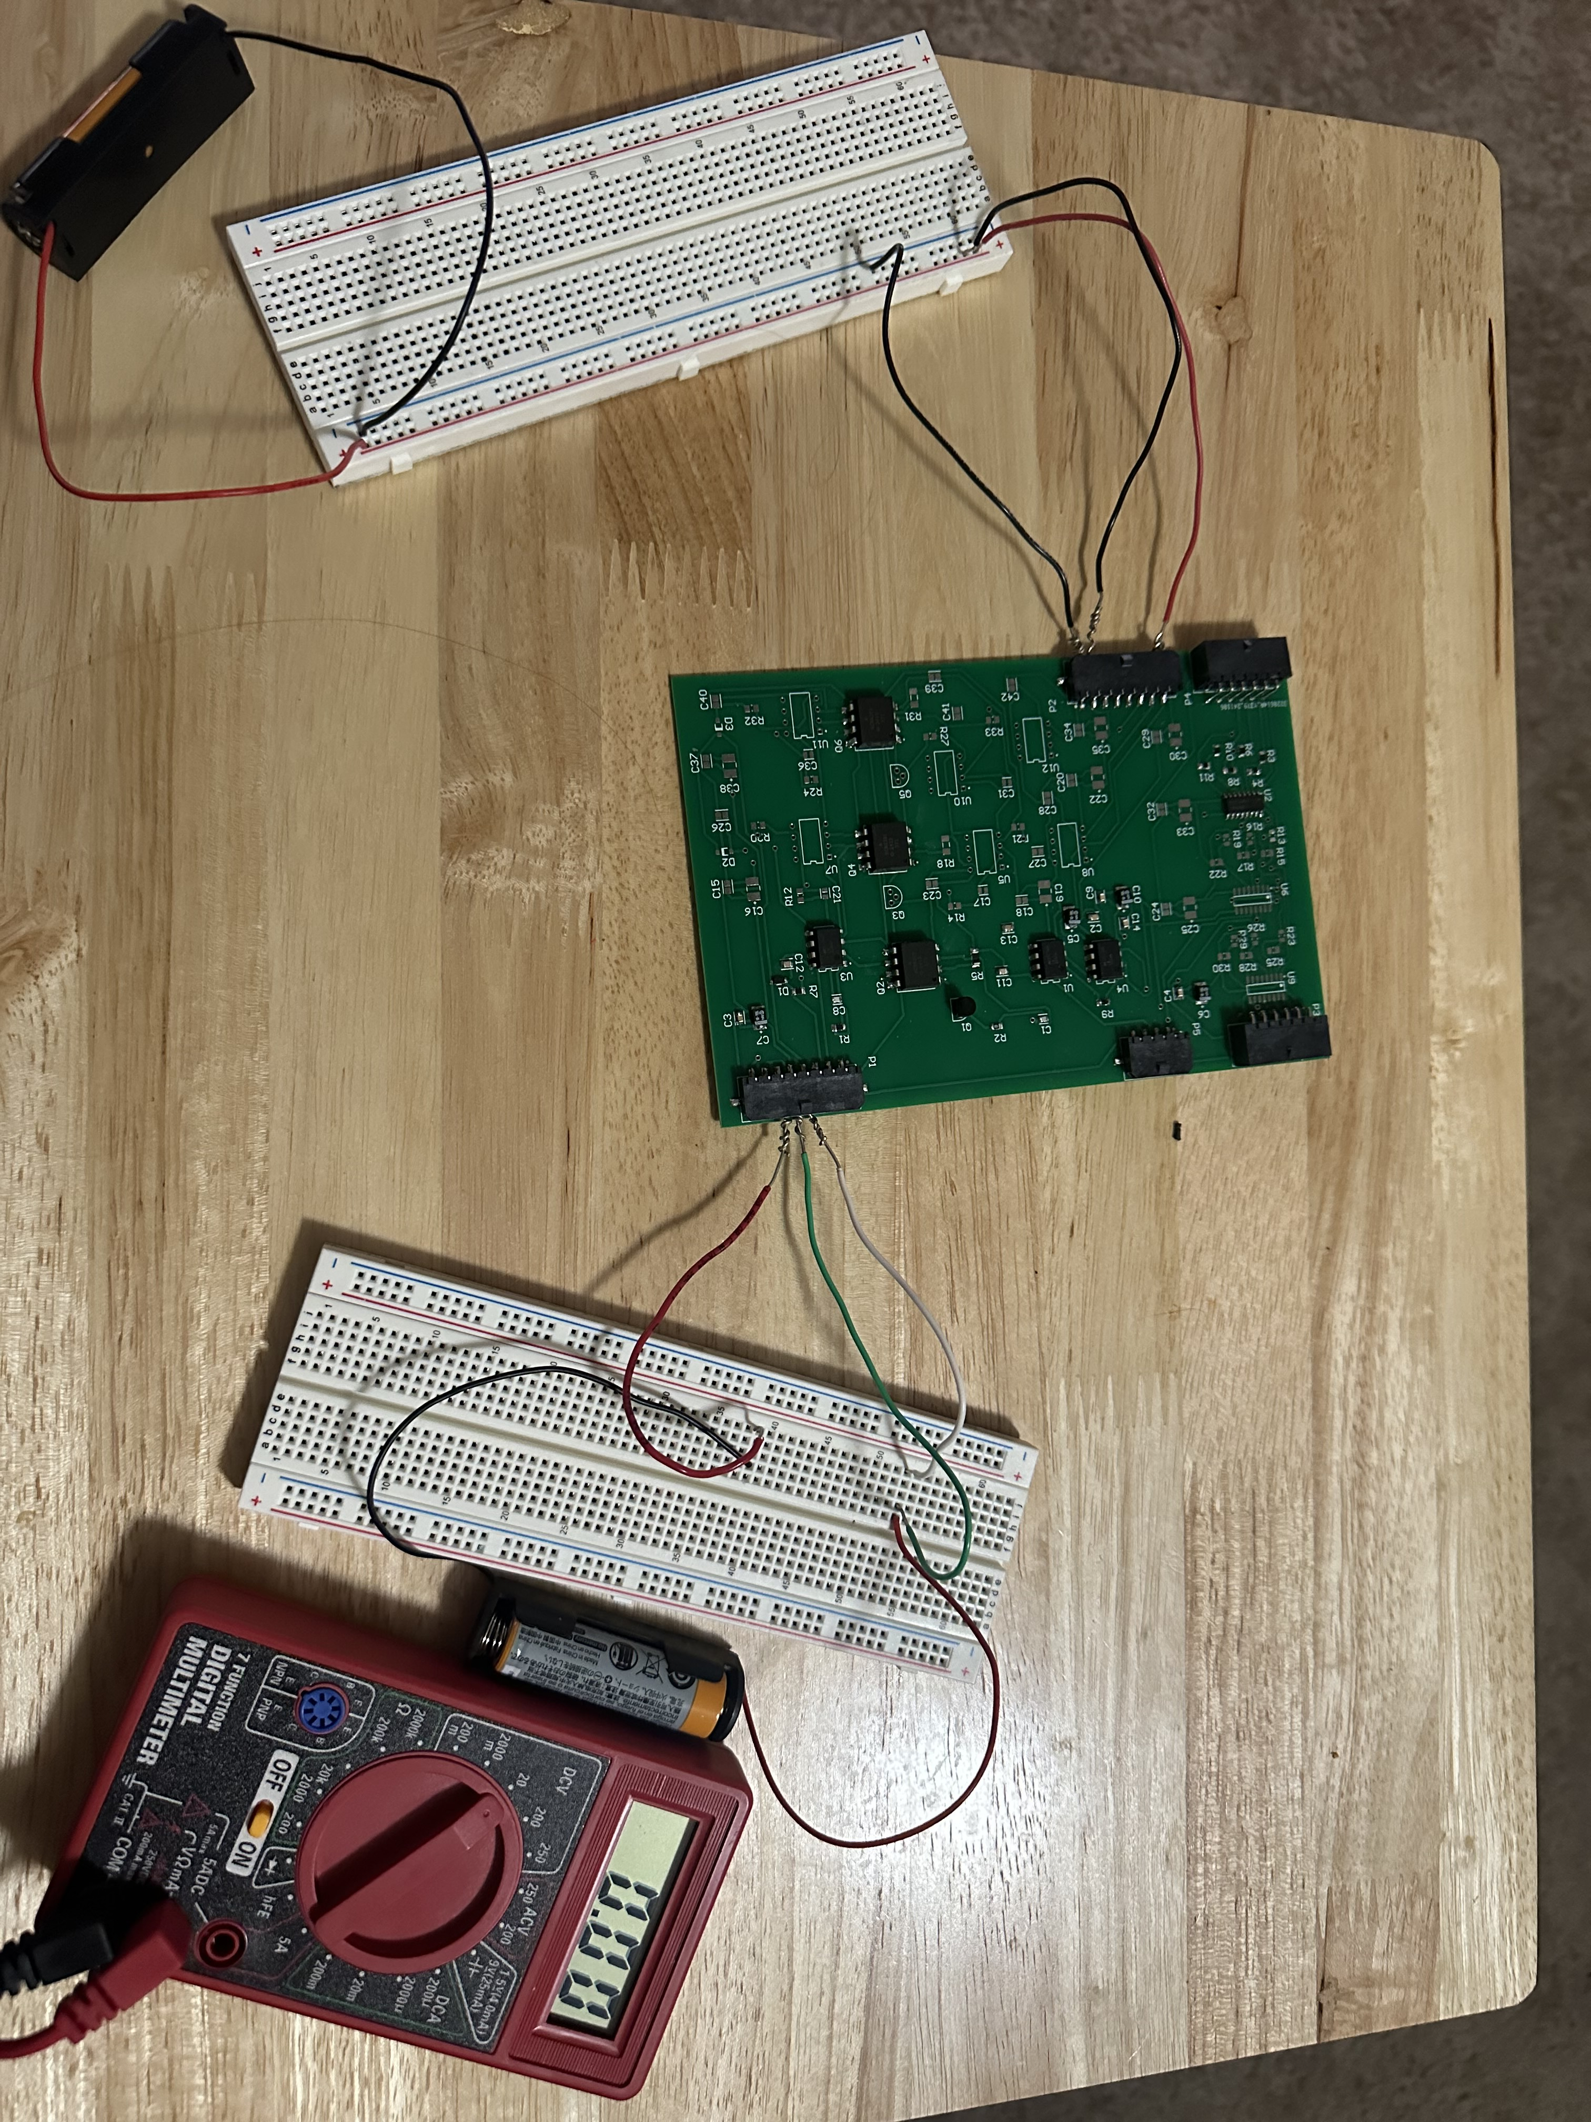
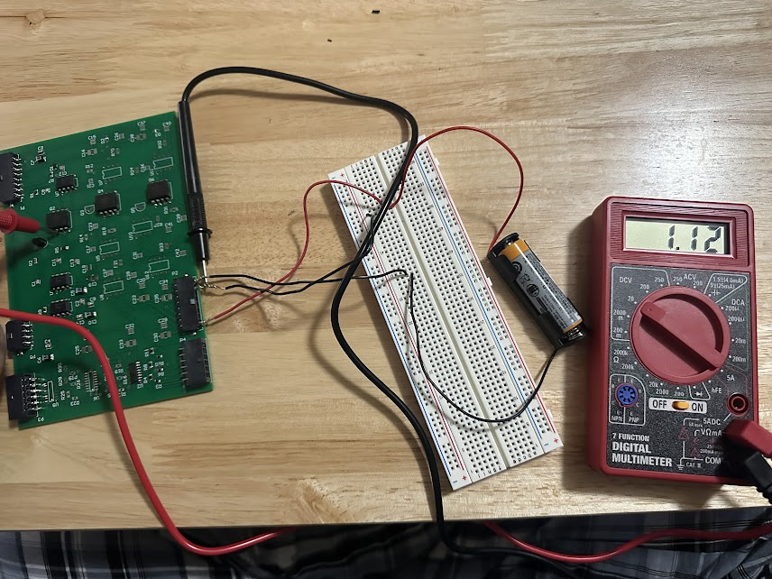
Optoelectronics Continued
Task | Status
PCB Fabrication | Complete
PCB Assembly | In progress

Slide 12
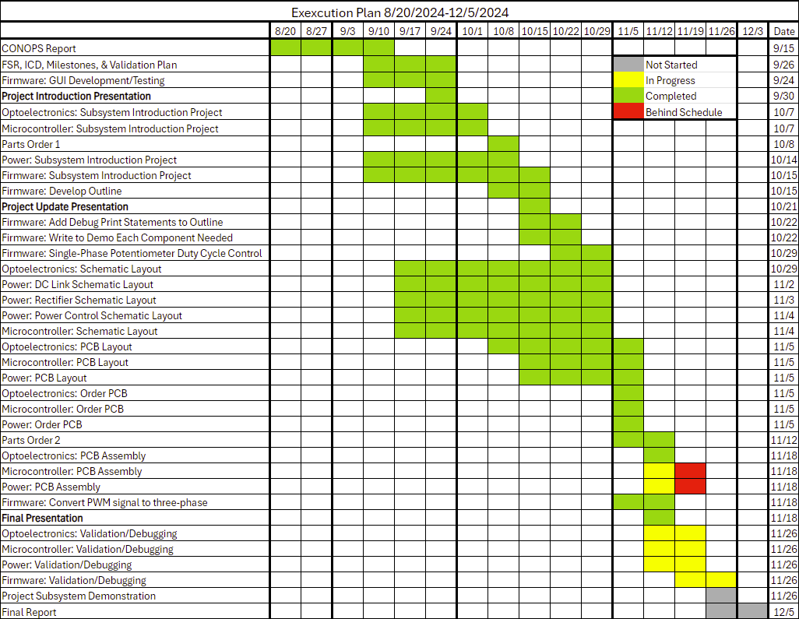

Slide 13
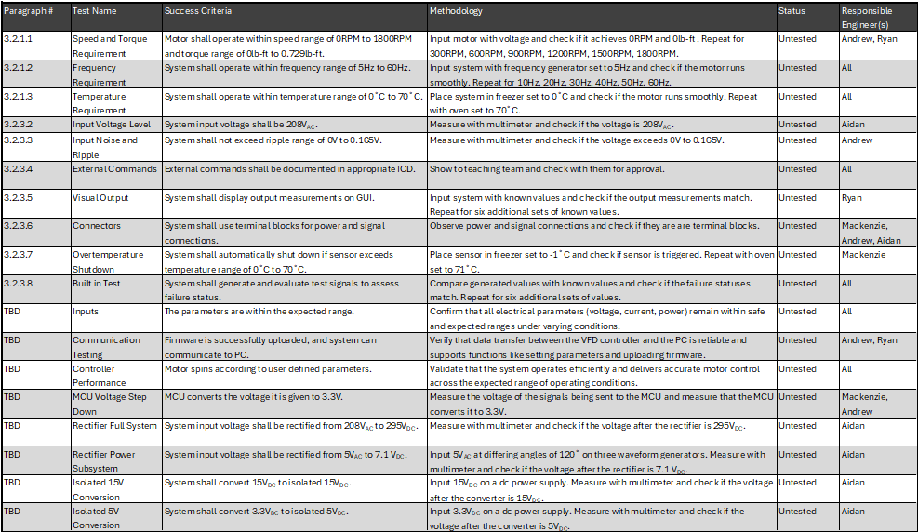
Validation Plan

Slide 14
Remaining Tasks
Microcontroller: Solder parts onto PCB, debug PCB, prepare for demo. For 404: ensure connections are correct to put all PCBs together, may need to redesign pcb/schematic to align with the other PCBs
Firmware: Before project demo, figure out proper scale for PWM signal, and add more debugging tools for future use and to ensure code is running exactly as intended. For 404: test dev board code with motor, then alter the firmware to work with our own microcontroller

Slide 15
Remaining Tasks Continued
Optoelectronics: Finish assembling PCB, test at full power, make sure PCB connectors are compatible with the other PCBs. For 404: implement tachometer on motor – connections are currently routed on PCB

Slide 16
Remaining Tasks Continued
Power
Aidan Rader
403 Tasks | Status
15V to Isolated 15V | assembled, not successfully validated
3.3V to Isolated 5V | assembled, not successfully validated
DC Link | not assembled, not validated
Power Control PWM Signals | not simulated
Power Control | not assembled, not validated (needs PWM signals)
404 Tasks: simulate circuit, redesign PCB (connectors facing outwards, fuse clip spacing, MCU 3 phase connector, increase PCB density), full motor control at 208VAC

